Slide 1



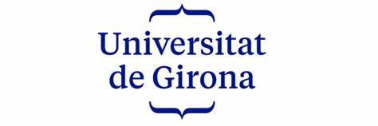
Diabetic Retinopathy Detection With Deep Learning
APTOS 2019 DIABETIC RETINOPATHY CLASSIFICATION CHALLENGE:
Presentation by:
Daniel Tweneboah Anyimadu

Slide 2
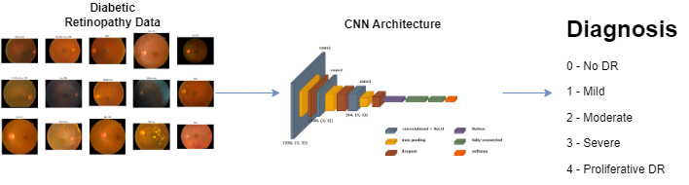
ABSTRACT
The project utilized the APTOS-2019 blindness challenge dataset, conducting exploratory data analysis, preprocessing, and augmentation. A CNN architecture was designed to extract features from retinal images for classification.
The model's performance was assessed using various metrics, with a focus on test accuracy and Balanced Multiclass Accuracy. These metrics yielded values of 0.8153 and 0.8068, respectively, showcasing the model's effectiveness.
This project leverages Convolutional Neural Networks (CNNs), a powerful class of deep learning models, to automatically analyze retinal images and classify them into different stages of DR.
The goal is to develop a robust and accurate diagnostic model to classify DR severity into five stages: No DR, Mild, Moderate, Severe, and Proliferative DR.
2

Slide 3
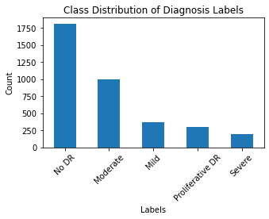
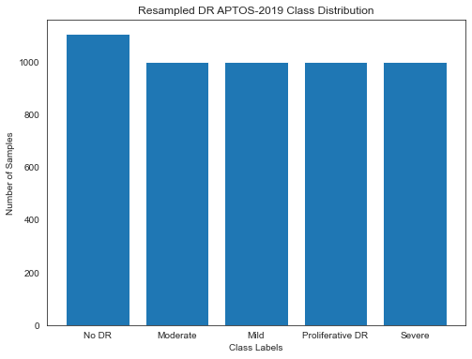
Exploratory Data Analysis (EDA) & Resampling
Class Distribution Plot:
Resampling Plot:
Imbalanced Diabetic Retinopathy stages illustrated in the class distribution plot.
Resampling (upsampling, downsampling) technique was employed to address class imbalance while preserving the distribution of real-world DR cases as shown in the resampling plot.
3

Slide 4
Train-Test Split, Data Augmentation & Generators
Train-Test Split:
Performed train-test split by creating subsets of the resampled training data.
This was split into 70% training, while the remaining 30% formed the test dataset.
A seed value of 42 was set for reproducibility, ensuring consistent randomization of data.
Data Augmentation:
Applying data augmentation techniques like normalization and shear transformation, the model becomes more robust and less prone to overfitting.
Generators for training, validation and testing:
allow the model to efficiently load and preprocess data in batches during training and evaluation.
4

Slide 5
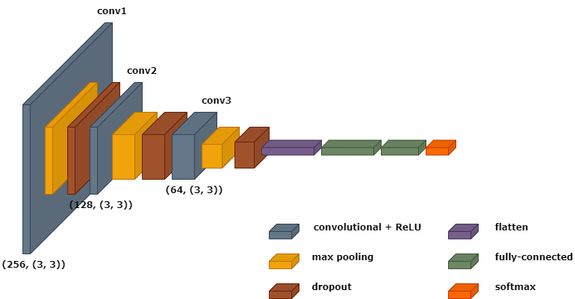
A Pure Deep Learning Approach
Convolutional Neural Network Architecture:
This is designed to automatically learn and extract retinal image features for multiclassification task.
5

Slide 6
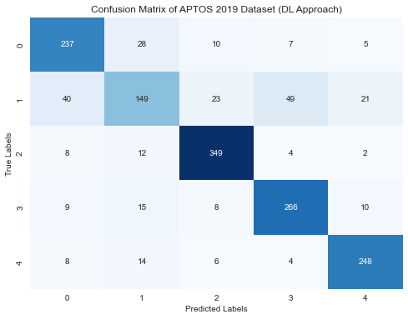
PERFORMANCE EVALUATION
EVAL. METRIC / MODEL | Accuracy | precision | recall | F1-score | roc_auc | bma
CNN model | 0.8153 | 0.8091 | 0.8152 | 0.8100 |  | 0.8068
The diagonal elements signify correct predictions, while off-diagonal elements indicate misclassifications.
For the "No DR (0)" class, correct predictions: 237
Misclassification:
"Mild (1)": 28, "Moderate (2)": 10, "Severe (3)": 7,
"Proliferative DR (4)": 5
Similarly for other classes, correct predictions:
"Mild (1)": 149, "Moderate (2)": 349, "Severe (3)": 266,
"Proliferative DR (4)": 248
6

